Slide 1
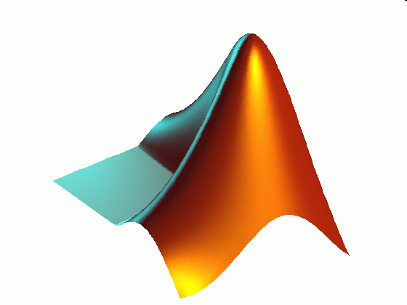
ME 203 Introduction to MATLAB
1

Slide 2
Rounding
B = round(A) Rounds the elements of X to the nearest integers. Positive elements with a fractional part of 0.5 round up to the nearest positive integer. Negative elements with a fractional part of -0.5 round down to the nearest negative integer. For complex X, the imaginary and real parts are rounded independently.
B = fix(A) Rounds the elements of A toward zero, resulting in an array of integers.
B = ceil(A) Rounds the elements of A to the nearest integers greater than or equal to A.
B = floor(A) Rounds the elements of A to the nearest integers less than or equal to A.

Slide 3
Rounding Example
A = [-1.9, -0.2, 3.4, 5.6, 7.0]
B=round(A)
C=ceil(A)
D=fix(A)
F=floor(A)
A =
-1.9000 -0.2000 3.4000 5.6000 7.0000
B =
-2 0 3 6 7
C =
-1 0 4 6 7
D =
-1 0 3 5 7
F =
-2 -1 3 5 7

Slide 4
Sums and Products
sum(x) Returns the sum of the elements in vector x, or the row vector of the sum of elements of each column in matrix x
prod(x) Returns the product of the elements in vector x, or the row vector of the product of elements of each column in matrix x
cumsum(x) Returns a vector the same size as x containing the cumulative sum of the elements in vector x, or a matrix the same size as x containing cumulative sums of values from the columns of x
cumprod(x) Returns a vector the same size as x containing the cumulative product of the elements in vector x, or a matrix the same size as x containing cumulative products of values from the columns of x
factorial(x) Returns the product of all positive integers less than or equal to x
Notes:
A=[1,2,3,4,5];

Slide 5
Sums and Products Example
x = [2 8 4 7 3 9];
y1=sum(x)
y2=prod(x)
y3=cumsum(x)
y4=cumprod(x)
f=factorial(6)
y1 =
33
y2 =
12096
y3 =
2 10 14 21 24 33
y4 =
2 16 64 448 1344 12096
f =
720

Slide 6
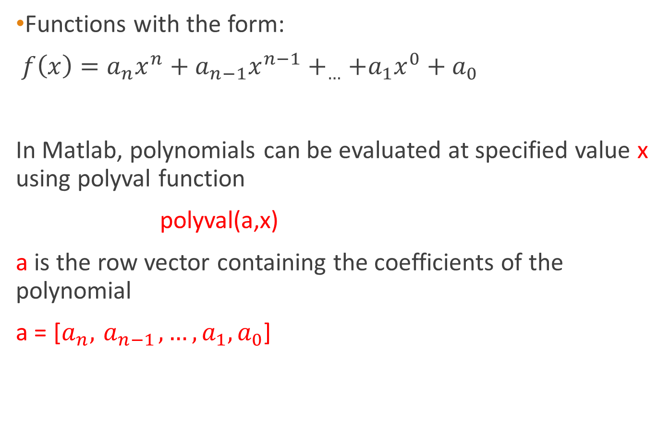
Polynomials
Functions with the form:
$f\left(x\right)=a_{n}x^{n}+a_{n−1}x^{n−1}+_{…}+a_{1}x^{0}+a_{0}$
In Matlab, polynomials can be evaluated at specified value x using polyval function
polyval(a,x)
a is the row vector containing the coefficients of the polynomial
a = [$a_{n},{ a}_{n−1}, …,a_{1},a_{0}$]

Slide 7

Polynomials
Example
Polynomial of degree two:$f\left(x\right)=2x^{2}−4x+10$. Find the value of the polynomial at a point x=2
Find the value of the polynomial at a point x=1,3,5
>> a = [2,-4,10];
>> polyval (a, 2)
ans =
10
>> polyval (a,[1,3,5])
ans =
8 16 40
Notes:
2x^2-4x+10

Slide 8

Polynomials
Find f(4) for the following function
$$7−x−4x^{3}+x^{5}$$
What is the coefficient vector?
Re-write the equation: $x^{5}+0x^{4}−4x^{3}+0x^{2}−x+7$
a = [1, 0, -4, 0, -1, 7]
polyval (a,4)
ans =
771
Note: placeholder 0 for x⁴ and x² terms
Notes:
7-x-4x^3+x^5

Slide 9
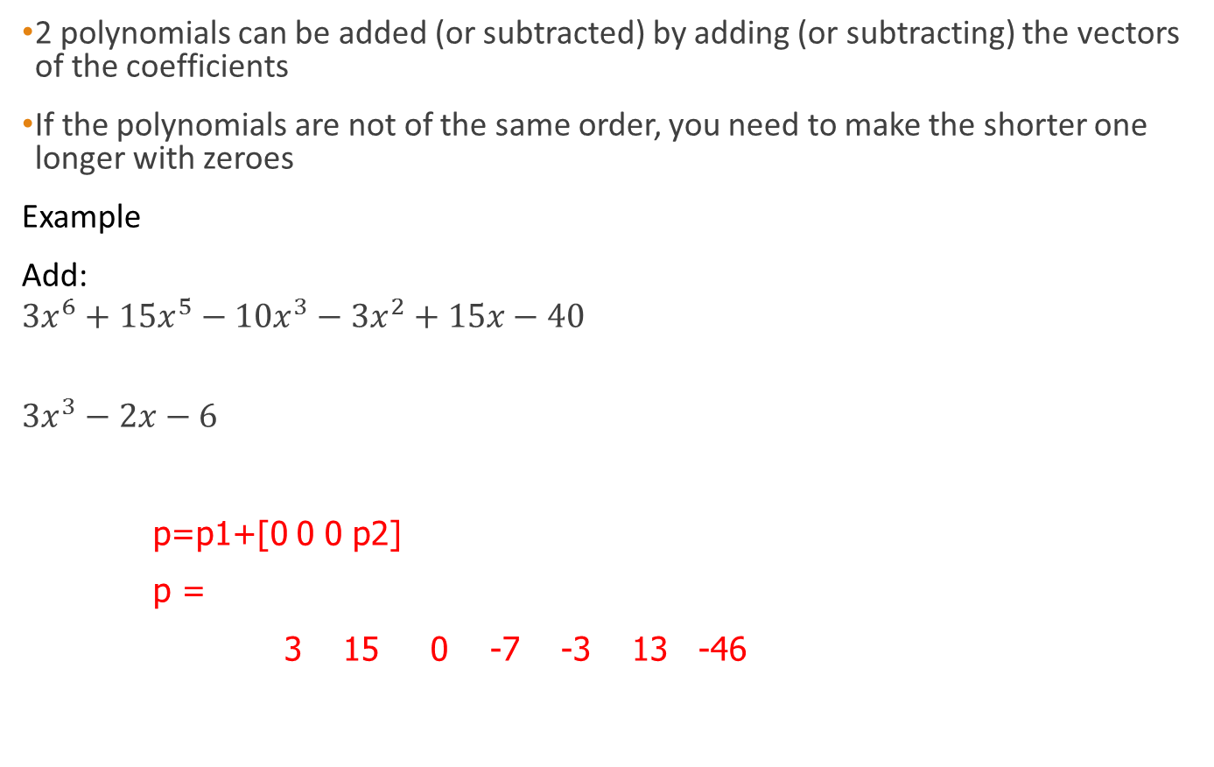
Adding Polynomials
2 polynomials can be added (or subtracted) by adding (or subtracting) the vectors of the coefficients
If the polynomials are not of the same order, you need to make the shorter one longer with zeroes
Example
Add:
$${3x}^{6}+{15x}^{5}−10x^{3}−3x^{2}+15x−40$$
$$3x^{3}−2x−6$$
p=p1+[0 0 0 p2]
p =
3 15 0 -7 -3 13 -46
p1=[3, 15, 0, -10, -3, 15, -40]
p2=[3, 0, -2, -6]
Notes:
3x^6+15x^5-10x^3-3x^2+15x-40
3x^3-2x-6

Slide 10
Multiplying Polynomials
2 polynomials can be multiplied with a built in function
Matlab function: c=conv (a,b)
The polynomials do not have to be the same order
c is the vector of the coefficients of the polynomial after multiplication
a and b are the vectors of the coefficients of the polynomials that are being multiplied

Slide 11

Multiplying Polynomials
Example:
$$\left({3x}^{6}+{15x}^{5}−10x^{3}−3x^{2}+15x−40 \right)∗\left(3x^{3}−2x−6 \right)$$
p1 = [3,15,0,-10,-3,15,-40]
p2 = [3,0,-2,-6]
conv(p1,p2)
9 45 -6 -78 -99 65 -54 -12 -10 240

Slide 12
Dividing Polynomials
A polynomial can be divided by another with a built in function
Matlab function: [q,r]=deconv (u,v)
The polynomials do not have to be the same order
q is the vector of the coefficients with the quotient polynomial
r is the vector of the coefficients of the with the remainder polynomial
u is the vector with the coefficients of the numerator polynomial.
v is the vector with the coefficients of the denominator polynomial

Slide 13



Dividing Polynomials
Example: $\frac{x^{3}−4x^{2}+2x−3}{x+2}$
num = [1, -4, 2, -3]
den = [1, 2]
[q, r] = deconv(num, den)
q =
1 -6 14
r =
0 0 0 -31
$$x^{2}−6x+14$$
$$\frac{\text{−31}}{}$$
Notes:
x^3-4x^2+2x-3
x+2
conv(den, q) + r

Slide 14
Linear Regression
Linear Regression - Fitting a line to a set of data
This is useful when you want to use the line for further calculations instead of the data
(In EXCEL it is called a trendline)
Actual Data
x = 0:5;
y = [0 20 60 68 77 110];
Approximation using
linear regression
y_hat = 20*x
How do we find the linear regression line in Matlab?
Notes:
x = 0:5;
y = [0 20 60 68 77 110];

Slide 15
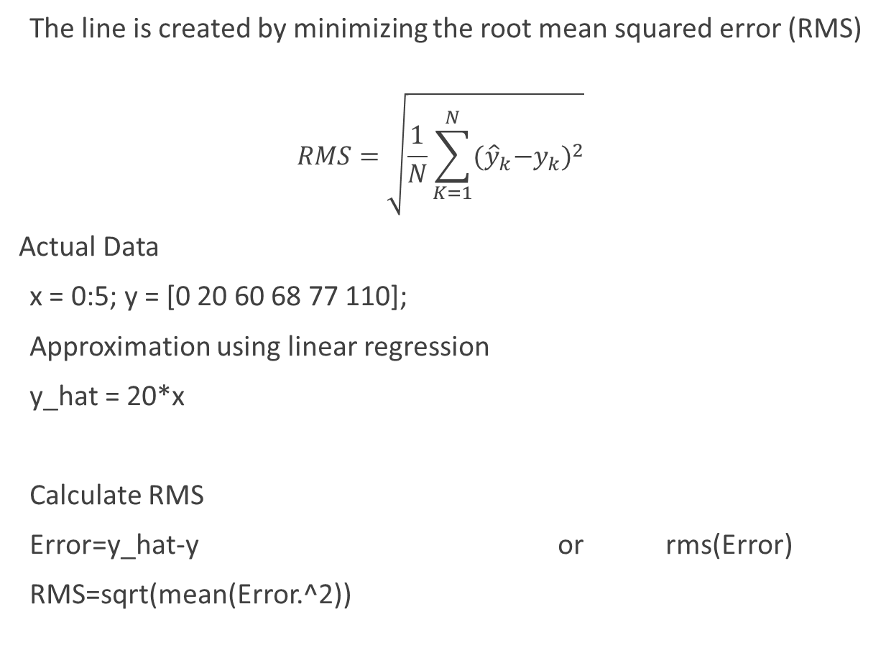
RMS
The line is created by minimizing the root mean squared error (RMS)
$$RMS=\sqrt{\frac{1}{N}\sum_{K=1}^{N}{{{(\hat{y}}_{k}−y_{k})}^{2}}}$$
Actual Data
x = 0:5; y = [0 20 60 68 77 110];
Approximation using linear regression
y_hat = 20*x
Calculate RMS
Error=y_hat-y or rms(Error)
RMS=sqrt(mean(Error.^2))

Slide 16
Polyfit
Polyfit calculates the coefficients of a polynomial that minimizes the RMS for the data set
Coefficients = polyfit (x data, y data, order of polynomial)

Slide 17

Polyfit
Ex: Linear Polynomial Fit
x = 0:5; y = [0 20 60 68 77 110];
a = polyfit(x,y,1)
a =
20.8286 3.7619
The coefficients in a are in descending powers of x
$$f\left(x\right)=a_{1}x^{1}+a_{0}$$
a₁= 20.8286 a₀=3.7619

Slide 18
Polyval
Polyval can be used to evaluate the value of a best-fit polynomial at a point
Result = polyval (coefficients, value to evaluate)
Ex: Continuing previous example. Estimate using Polyval, value of y when x=5.
a=polyfit(x,y,1)
a =
20.8286 3.7619
polyval(a,5)
ans =
107.9048
Actual data: x = 5; y = 110

Slide 19
Linear Regression Example
Data Set
Time in seconds, x = 0:5;
Temperature in ⁰F, y = [0 20 60 68 77 110]
a) Write a code to plot the data and a best fit line
- Use circles for the data and a line for the best fit line
- Completely label the plot
- Display the coefficients for the polynomial approximation
b) Calculate the RMS error of the linear approximation
%Linear regression example
clc; clear; format compact
%Given
x = 0:5; %seconds
y = [0 20 60 68 77 110]; %degree F

Slide 20
Linear Regression Example
%Part a
a = polyfit(x,y,1) %gives equation of best-fit line
y_hat = polyval(a,x); %y values using the equation of line
plot(x,y,'o') %plot based on given data
hold on
plot(x,y_hat) %plot based on the equation of line
title('Linear regression')
xlabel('time, s')
ylabel('Temperature, degrees F')
legend('measured','estimated')
grid on

Slide 21
Linear Regression Example
%Part b
error = y_hat - y;
RMS1 = sqrt(mean(error.^2))
%Alternatively use the Root-mean-square level function in matlab
RMS2 = rms(error)

Slide 22
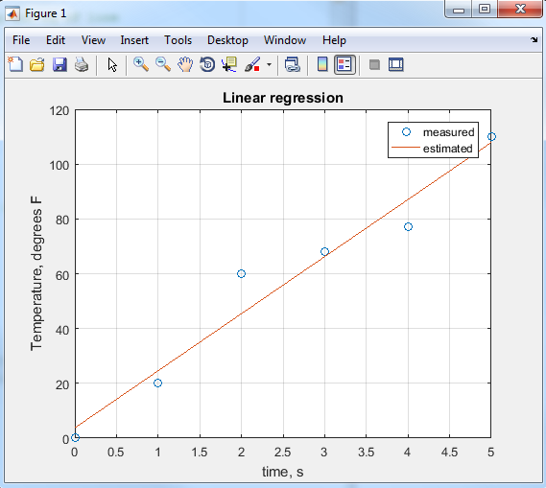
Linear Regression Example
Results
a =
20.8286 3.7619
RMS1 =
7.7117
RMS2 =
7.7117

Slide 23
Polynomial integration
Polyint function calculates the integral of polynomials
q = polyint(p) integral of the polynomial p, assuming constant of integration as zero
q = polyint(p, C) integral of the polynomial p with C as the constant of integration

Slide 24

Polynomial integration
Integral of : $3x^{2}+15x−40$ , constant of integration =10
>>p(x) = p = [3, 15, -40]
>> q = polyint(p,10)
>> q =
1.0000 7.5000 -40.0000 10
q(x) = $x^{3}+{7.5x}^{2}−40x+10$

Slide 25
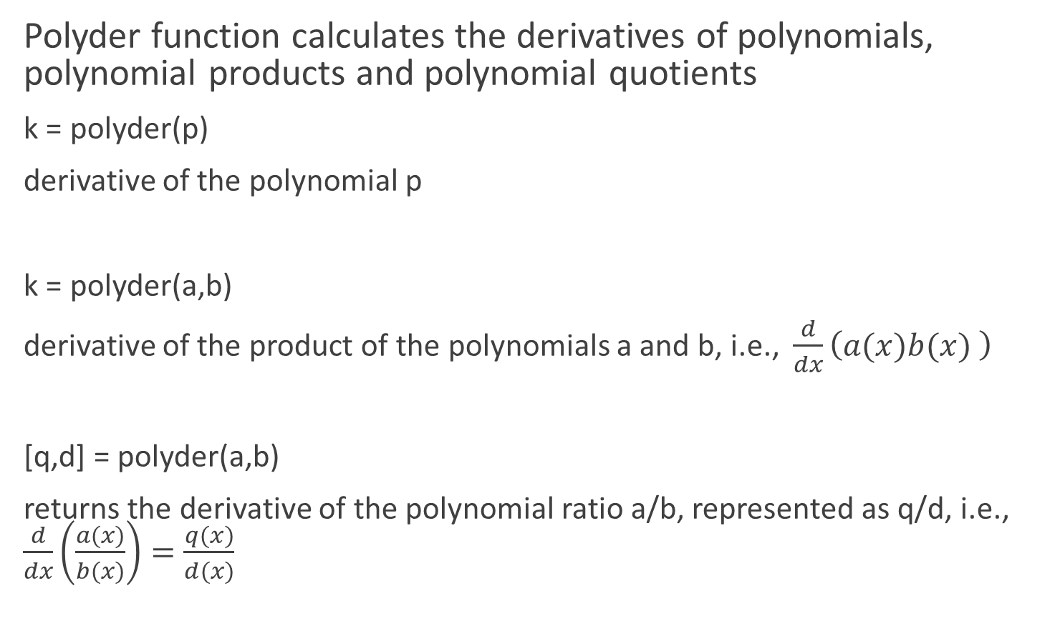
Polynomial differentiation
Polyder function calculates the derivatives of polynomials, polynomial products and polynomial quotients
k = polyder(p)
derivative of the polynomial p
k = polyder(a,b)
derivative of the product of the polynomials a and b, i.e., $\frac{d}{dx}\left(a(x)b(x) \right)$
[q,d] = polyder(a,b)
returns the derivative of the polynomial ratio a/b, represented as q/d, i.e., $\frac{d}{dx}\left(\frac{a(x)}{b(x)}\right)=\frac{q(x)}{d(x)}$

Slide 26

Polynomial differentiation
Example: $\frac{d}{dx}\left(\frac{x^{3}−4x^{2}+2x−3}{x+2}\right)$
a = [1, -4, 2, -3]
b = [1, 2]
[q, d] = polyder(a,b)
Notes:
x^3-4x^2+2x-3
x+2

